Slide 1
Education and the Human Brain
Włodzisław Duch
Katedra Informatyki Stosowanej UMK
Google: W. Duch
WCCE/IwE, 1-7.07.2013

Slide 2
Plan
In an ideal world …
Problems with the babies.
Neurocognitive phenomics, or what do we know about
Perception, will, motivation, consciousness.
Memes and conspiracy theories in the brain.
Implications and dreams.
You may say that I’m a dreamer …
But I hope not the only one.

Slide 3
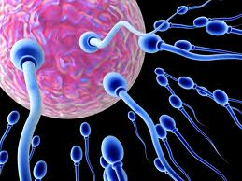
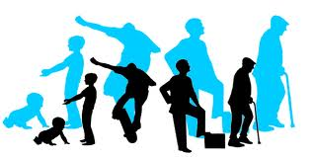
In an ideal world ...
Society would support full development of human potential, from conception to senior years. Does it?
Human potential is wasted in so many ways: in developing countries due to poor conditions, in rich countries due to the greed of big companies that encourage unhealthy lifestyles.
Education imparts knowledge, but can we successfully teach wisdom, understanding what is really good for children, what will make them happy in the long run?
Can technology help?

Slide 4
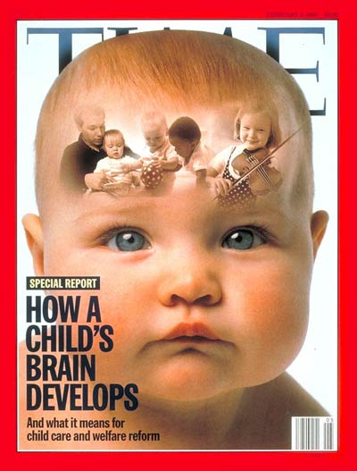
Innovative education
Standard: introduce new tool and see how it does influence learning.
Target: understand how the brain learns, what are the conditions for optimal development, how to increase creativity, encourage exploration, will power, motivation to learn.
Implementation: monitor how brains react, create environments and tools that have desired impact.

Slide 5
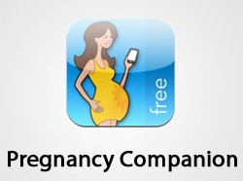
In an ideal world …
Children will be born in perfect condition.
In the first 9 month of our lives even small errors have disastrous consequences.
Problems arise due to genetic errors, viruses, disease, poisoning (including alcohol and nicotine), vitamin imbalance (A, B, E), but also lack of education of pregnant woman.
Understanding of various factors that can influence baby development, software for monitoring and giving informed advices is still in infancy, although some useful applications for smart phones exist. Computers may help us to learn about ourselves
in many ways.

Slide 6
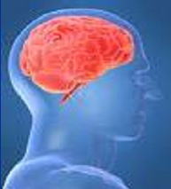
Genes and brains
Genetics is at the top now, but think about it:
C-elegans worm Human
19.000 genes 23.000 genes
302 neurons 100 billion neurons (10¹¹)
7800 synapses ~ 10¹⁴ – 10¹⁵ synapses
Conclusion: the number of genes is not directly connected to the complexity of brain. The way DNA is decoded depends on many epigenetic factors, and it may be easier to control them.

Slide 7
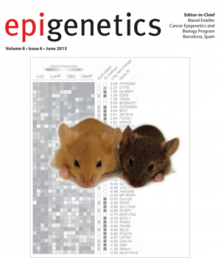
In an ideal world …
Child obesity would not exist.
Diseases of affluence affect large percentage of young children, type 2 diabetes, asthma, coronary heart disease, cerebrovascular disease, peripheral vascular disease, obesity, hypertension, addictions, allergies, developmental problems … Relations between environmental factors, food and health should be studied and technology used for training, monitoring and explaining the consequences of our choices and actions.
The first World Conference on Early Childhood Care and Education took place in Moscow in September 2010, jointly organized by UNESCO and the city of Moscow.

Slide 8
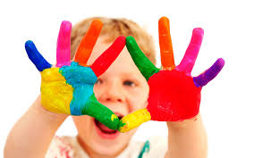
In an ideal world …
Babies would develop in an stimulating environment that will monitor their development, interact with them and encourage positive habits.
Motivation, curiosity, willingness to explore the world would develop in infancy.
Schools would help to form personality, develop emotional intelligence, empathy …
People would learn to set wise goals worth the required effort, increasing their happiness, not only self-promotion.
At each stage of life technology would support high quality of life, advice young people in decision making, help older people to keep their memories, social contacts, encourage activity.

Slide 9
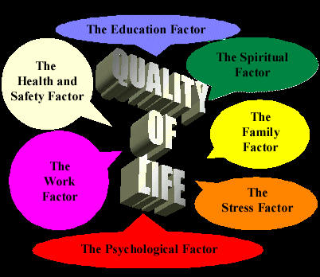
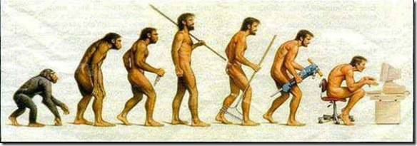
All we really want is a better quality of life

Slide 10
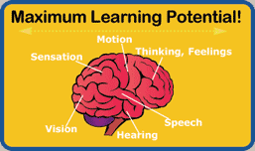
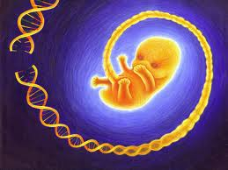
Brain problem
Brain is the ultimate engineering problem! How to nurture it? How to prepare brains for education?
Although genes set limits for potential individual development these limit are almost never reached, and genetic manipulation is not a solution.
“The early childhood years lay a foundation that influences the effectiveness of all subsequent education efforts.” US National Research Council, Committee on Integrating the Science of Early Childhood Development: “From Neurons to Neighborhoods: The Science of Early Childhood Development” (2000 report).
Challenge: prevent developmental abnormalities, boost optimal brain development.

Slide 11
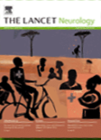
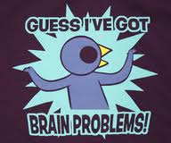
Global problem
Genetics sets the limits but random interactions of babies with their environment leaves no chance to achieve full development of inborn human potential.
The special issue of The Lancet (January 2007): Early childhood development: the global challenge. Article: Developmental potential in the first 5 years for children in developing countries.
At least 200 million children aged under 5 years fail to reach their potential in cognitive and socioemotional development, because of four causes: malnutrition that leads to stunting, iodine and iron deficiency, and inadequate stimulation in their first 5 years of life.

Slide 12
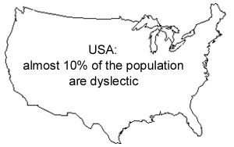
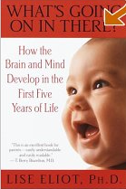
Developmental problems
5-10% of all children have developmental disabilities that cause problems with speech and language and later difficulties in learning. Without proper stimulation full in-born potential is not reached.
Genes specify only roughly where neurons should go (ex: eye to visual cortex, across the whole brain) too many neurons are created, and those unused die (apoptosis). Maximum number of neurons: 1-2 month before birth, although infant’s brain is only ¼ of the final size.
Max synaptic density in the 3 year of age.
General principle:
growing up is specializing = narrowing potential possibilities.
How to keep more possibilities open?

Slide 13
Neuroeducation
As educators you are sculpting brains!
Pedagogy has developed through trial and error, now technology that shows how experience and teaching creates pathways in the brain already exists.
Neuroeducation: interdisciplinary field that connects many branches of science, including pedagogy, psychology, neuroscience and informatics to understand information flow in the brain and create effective ways of teaching.
H.H. Donaldson wrote „The Growth of the Brain: A Study of the Nervous System in Relation to Education”, in 1895!
R.P. Halleck, The Education of the Central Nervous System: A Study of Foundations, Sensory and Motor Training, 1896!

Slide 14
Erosion
Questions of the King Milinda (Milinda Panha, ca. 400). Water erodes the soil and flows in the same riverbeds, just like neural activation flows in our brains, creating habits and memes.
New things are learned on the canvas of what we already know, the order in which we learn is important.
Notes:
Woda była jednym z ulubionych tematów merców starozytnych, strumień myśli jest jak płynący szybko strumień wody.

Slide 15
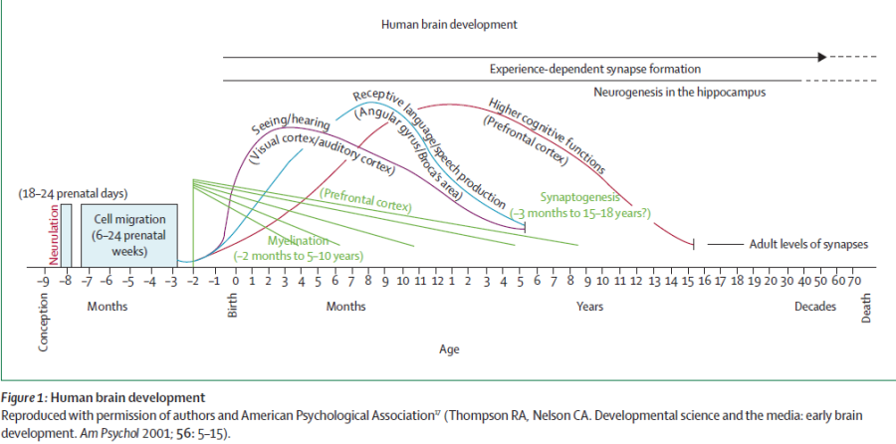
Synaptogenesis
Synaptogenesis creates, experience sculpts, leaving only useful pathways. After birth neurogenesis is limited to a brain few areas.

Slide 16
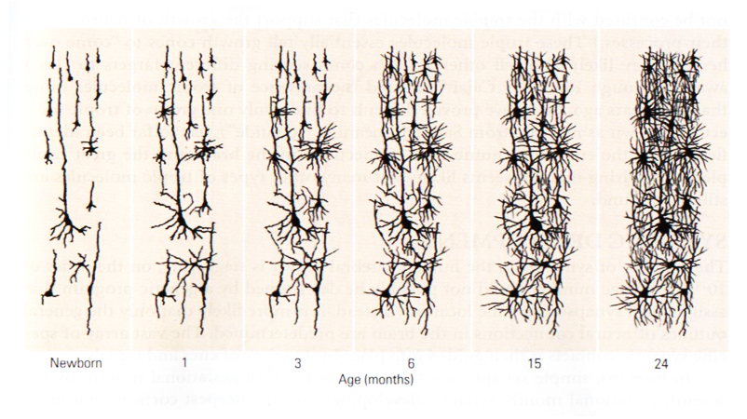
From 0 to 24 month
Brain at birth has only ¼ of its final mass, and creates a few million new connections per second!
Temporal cortex.

Slide 17
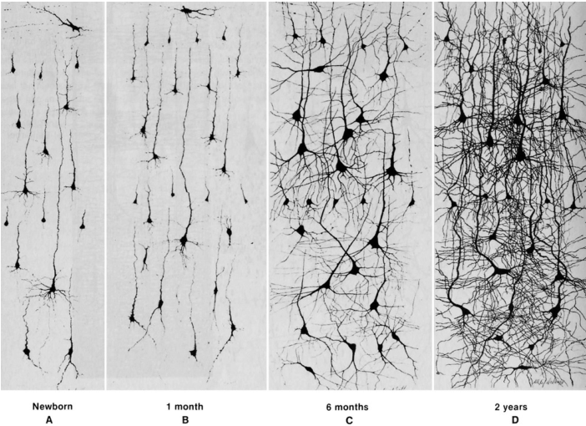
Medium Frontal Gyrus (MFG)
Notes:
From Courchesne and Pierce (2005a), adapted from Nolte (1993)

Slide 18
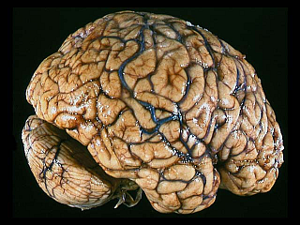
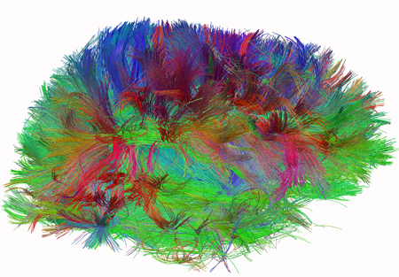
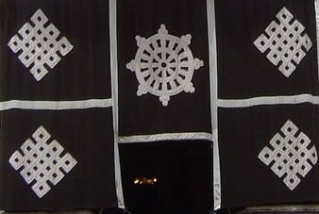
Neural determinism
Our possibilities are limited by genetic and neural determinism.
„Comes to my mind” = neural activity arising in a given context.
Neural determinism is the effect of genetic predisposition and individual experiences, family, social interactions, education.
There is no linear causality here, everything in time/space is one.

Slide 19
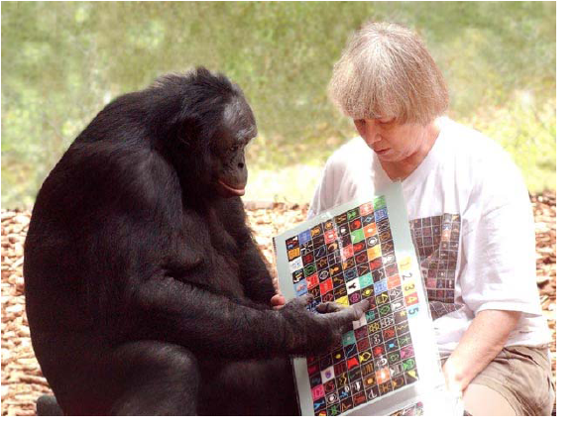
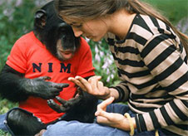
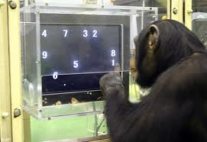
Simple brains
Chimps have better working memory than people, but they are less creative: 1/10 of our association cortex = less noise and better focus without background thoughts.
Chimps have rich social life, show altruistic and emphatic behavior, have sense of justice, may combine a few symbols and express simple intentions but stay at the level of 2-years old.

Slide 20
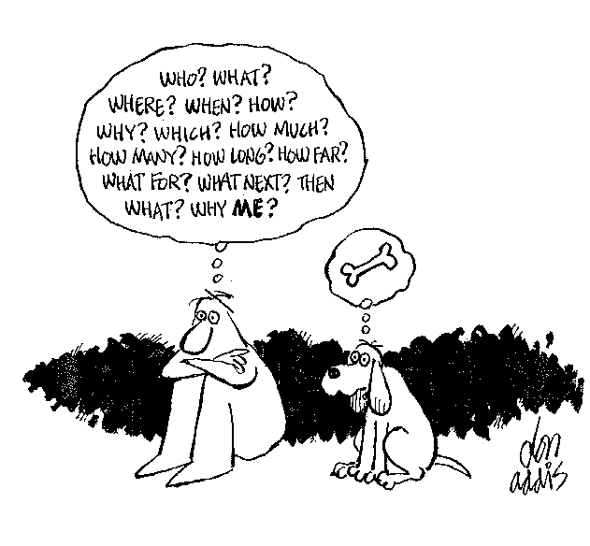

Slide 21
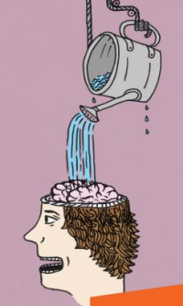
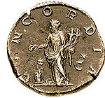
Educational questions
How strong is neural determinism? How strong are influences from learned behavioral patterns? Khmer Rouge children were given “leadership in torture and executions”, practicing torture on animals before killing people.
Should free choice be enforced on small babies?
From Greece to China positive and negative behavioral patterns have been provided through legends, dramas, religious stories, helping to learn virtues and values through personifications (arete, persona, bodhisatwa), self-regulation of behavior.
What is the source of values for young generation? Where are their role models? Harry Potter?

Slide 22
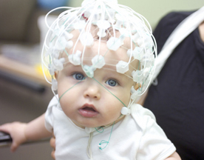
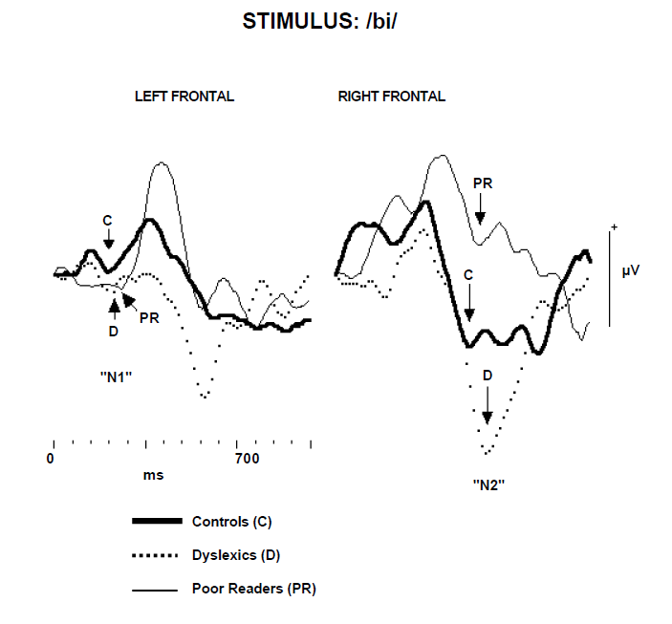
ERP and speech
D.L. Molfese used auditory event-related potentials recorded at birth to speech and nonspeech syllables.
Predictions based on ERPS: dyslexic, poor, or normal readers 8 years later (2nd grade), with 82% accuracy.
=> reading problems can be identified and possible interventions undertaken up to 9 years earlier than is currently possible.
Can this be changed?
ERP for high school students learning names for different countries as indicated after a 15 minute period how successful these students will be in learning to associate names with the outlines of different countries. ERPs allow for prediction when the material was mastered versus when students were only familiar with the material but had not yet mastered it.

Slide 23
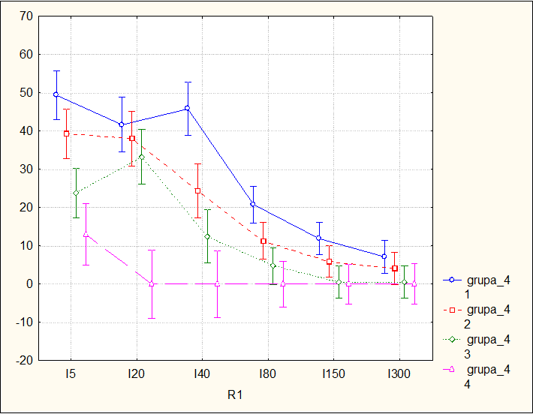
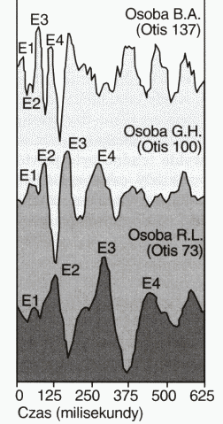
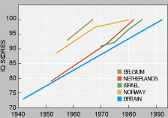
Abstract thinking
G. Marcus et al, “Rule learning by seven-month-old infants”, Science 1999.
7-month old babies habituated for 2 minutes with sentences like ga ti ga, li na li, of the ABA structure, recognize that wo fe wo has correct grammatical structure but wo wo fe does not.
Intelligence: speed of thinking + working memory + synaptic density reflected in ERP structure, later specific structure of connections will increase IQ, decrease creativity.
Strong correlation of IQ between the ability to order two very short sounds, one with higher pitch (ex. J. Drescher, Torun).
Lynn-Flynn effect: IQ grows everywhere in the world, 24 points in USA since 1918, 27 points in UK. Toys and nutrition help to develop better brains?

Slide 24
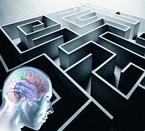
Solution
Understand how environment may influence development of nervous system, provide advice (apps).
Teach infants perception and cognition!
Supervise perceptual and cognitive development of infants.
Use interactive devices that stimulate infants, observe their reactions and provide precise feedback to improve their categorical perception.
Prevent developmental problems discovering them at early stages, call experts if necessary.
Encourage the infant brain to use working memory, stimulate discovery of abstract patterns in visual and auditory stimulations, increase speed of reactions ...

Slide 25
Phenomics
Phenomics is the branch of science concerned with identification and description of measurable physical, biochemical and psychological traits of organisms. Genom, proteom, phenom, interactom, exposome, virusom … omics.org has a list of over 400 various …omics. Human Phenome Project, since 2003. Human Epigenome Project, since 2003. Human Connectome Project, since 2009. Developing Human Connectome Project, UK 2013
Consortium for Neuropsychiatric Phenomics, since 2008 investigates phenotypes of people suffering from serious mental disorders at all possible levels.

Slide 26
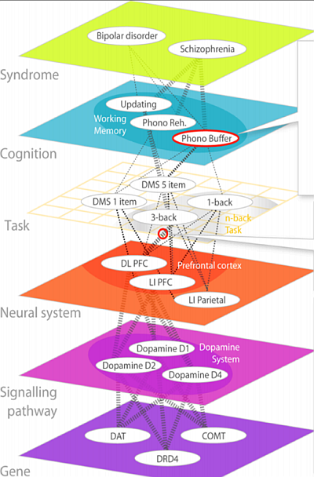
Neuropsychiatric Phenomics in 6 Levels
According to The Consortium for Neuropsychiatric Phenomics (CNP) http://www.phenomics.ucla.edu
From genes to molecules to neurons and their systems to tasks, cognitive subsystems and syndromes.
Neurons and networks are right in the middle of this hierarchy.

Slide 27
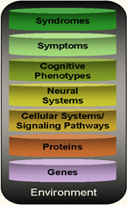
Strategy for Phenomics Research
The Consortium for Neuropsychiatric Phenomics: research should provide bridges between all levels, one at a time, from environment to syndromes.
Strategy: identify biophysical parameters of neurons required for normal neural network functions and leading to abnormal cognitive phenotypes, symptoms and syndromes.
Create models of cognitive function that may reflect some of the symptoms of the disease, ex. problems with attention, relating them to model biophysical properties of neurons.
Result: mental events at the network level are linked to neurodynamics and to low-level neural properties. Ex: why drugs that stimulate the brain help in ADHD case? Relation of ASD/ADHD symptoms to neural accommodation.

Slide 28
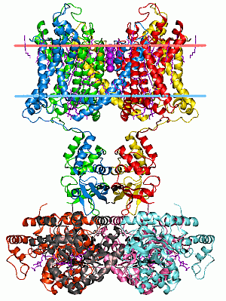
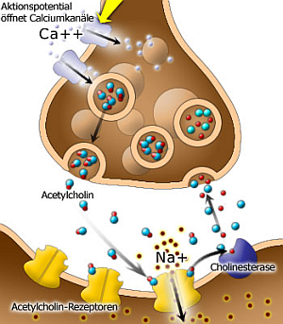
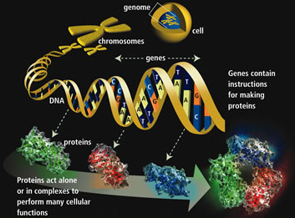
From Genes to Neurons
Genes => Proteins => receptors, ion channels, synapses => neuron properties, networks, neurodynamics => cognitive phenotypes, abnormal behavior, syndromes.

Slide 29
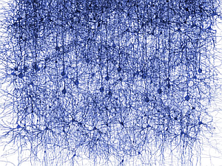
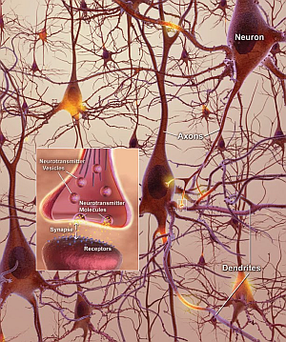
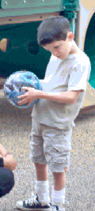
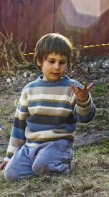
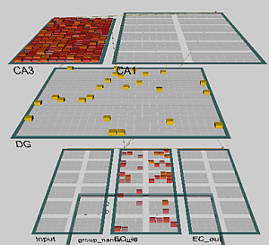
From Neurons to Behavior
Genes => Proteins => receptors, ion channels, synapses => neuron properties, networks
=> neurodynamics => cognitive phenotypes, abnormal behavior!

Slide 30
Neurocognitive Phenomics
Phenotypes may be described on many levels, here from top down it is pedagogics, psychiatry, psychology,
neurophysiology, neural networks,
biology, neurobiology,
biophysics, biochemistry, bioinformatics.
Neurocognitive phenomics is even greater challenge than neuropsychiatric phenomics, effects are more subtle.
Learning styles, strategies
Learning styles
Memory types,
attention …
Cognition
Sensory & motor activity, N-back …
Tasks, reactions
Specialized brain areas, minicolumns
Neural networks
Many types of neurons
Synapses, neurons & glia cells
Neurotransmitters & modulators
Signaling pathways
Genes & proteins, brain bricks
Genes, proteins, epigenetics

Slide 31
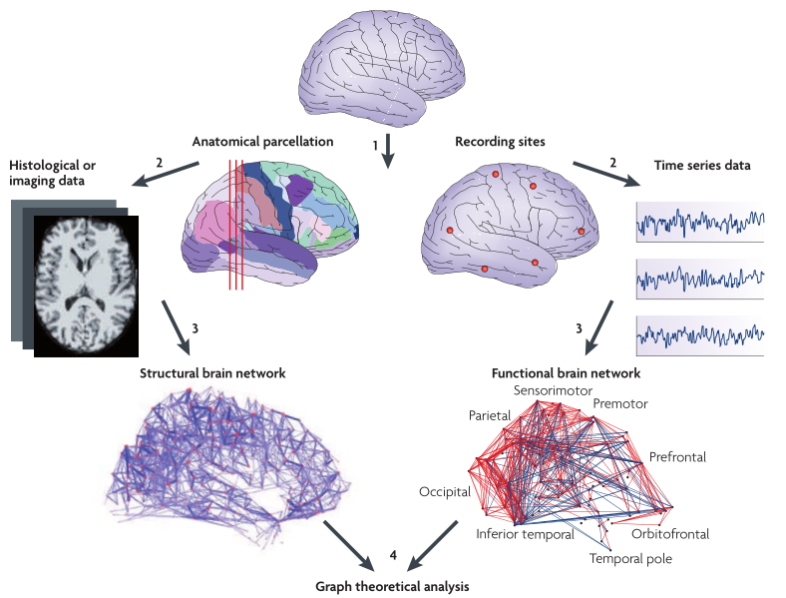
Structure and function
Notes:
Ed Bullmore and Olaf Sporns, Complex brain networks: graph theoretical analysis of structural and functional systems. Nature Reviews Neuroscience 10, 186-198 (March 2009) | doi:10.1038/nrn2575

Slide 32
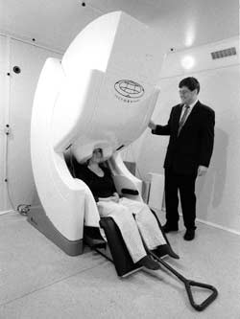
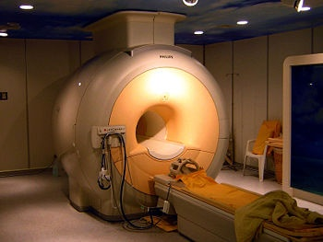
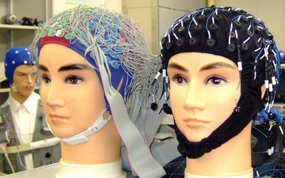
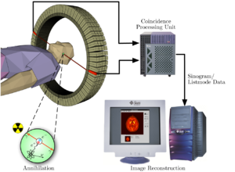
Our toys

Slide 33
Język (165 eksperymentów)
Sieci funkcjonalne
M. Anderson, BBS 2010

Slide 34
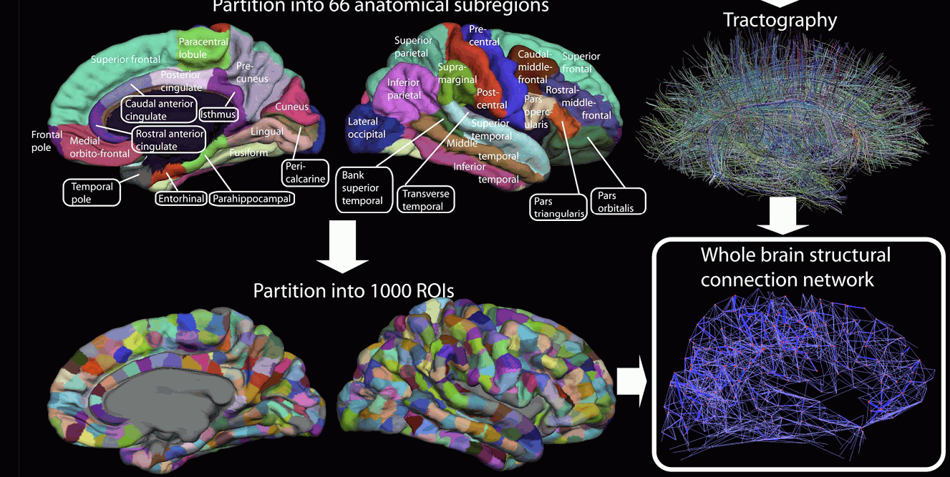
Connectome
Brodmann areas are not sufficient, more detailed picture will distinguish 1000 regions of interest (ROI) and their activations. Concept = sustained prototype activity of ROIs.

Slide 35
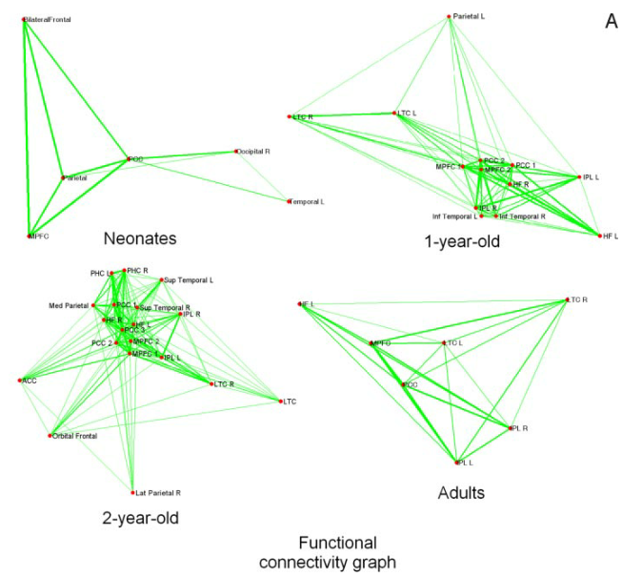
Default Mode Network (DMN)
Notes:
Evidence on the emergence of the brain’s default network from 2-week-old to 2-year-old healthy pediatric subjects
Wei Gao, Hongtu Zhub, Kelly S. Giovanello, J. Keith Smith, Dinggang Shen, John H. Gilmore, and Weili Lin, 6790–6795 PNAS April 21, 2009 vol. 106 no. 16.
Default mode network consists mainly of the ventral/dorsal medial prefrontal cortex (v/d MPFC), posterior cingulate cortex/retrosplenial (PCC/Rsp), inferior parietal lobule (IPL), lateral temporal cortex (LTC), and hippocampus regions (HF).

Slide 36
Learning styles
David Kolb, Experiential learning: Experience as the source of learning and development (1984), and Learning Styles Inventory.

Slide 37
Learning connectome styles
Simple connectome models may help to connect and improve learning classification of the styles.
S, Sensory level, occipital, STS, and somatosensory cortex;
C, central associative level, abstract concepts that have no sensory components,
M=Motor
C=Central
World
S=Sensory
mostly parietal, temporal and prefrontal lobes;
M, motor cortex, motor imagery & physical action. Frontal cortex, basal ganglia.
Even without emotion and reward system predominance of activity within or between these areas explains many learning phenomena.

Slide 38
Learning styles 1st D
Kolb perception-abstraction: coupling within sensory S⬄S areas, vs. coupling within central C⬄C areas. Strong C=>S leads to vivid imagery dominated by sensory experience. Autism: vivid detailed imagery, no generalization.
M=Motor
C=Central
World
S=Sensory
Attention = synchronization of neurons, limited to S, perception S⬄S strongly binds attention, no chance for normal development. Asperger syndrome strong C=>S activates sensory cortices preventing understanding of metaphoric language.
If central C⬄C processes dominate, no vivid imagery but efficient abstract thinking is expected - mathematicians, logicians, theoretical physicist, theologians and philosophers ideas.

Slide 39
Learning styles 2nd D
Kolb passive-active dimension, observation – experimentation: motor-central processes M⬄C, sensory-motor processes M⬄S. Autistic people: processes at the motor level M⬄M, leads to repetitive movements, echolalia.
M=Motor
C=Central
World
S=Sensory
The Learning Styles Inventory is a tool to determine learning style. Divides people into 4 types of learners:
divergers (concrete, reflective),
assimilators (abstract, reflective),
convergers (abstract, active),
accommodators (concrete, active).

Slide 40
4 styles and more
Assimilators think and watch: prone to abstract thinking, reflective observation, inductive reasoning due to strong connections S=>C and within C⬄C, weak connections from S=>M and C=>M.
Convergers combine abstract conceptualization, active experimentation, using deductive reasoning in problem solving. Strong C⬄C and C=>M flow of activity.
Divergers focus on concrete experience S⬄S, strong C⬄S connections and C⬄C activity facilitating reflective observation, strong imagery, novel ideas but weak motor activity.
Accommodators have balanced sensory, motor and central processes and thus combine concrete experience with active experimentation supported by central processes S⬄C⬄M.
Objective tests of the learning style may be based on brain activity.

Slide 41
Origin of the learning styles
Connectomes develops before birth and in the first years of life.
Achieving harmonious development is very difficult and depends on low-level (genetic, epigenetic, signaling pathways) processes, but may be influenced by experience and learning.
Excess of low-level (sensory) processes S⬄S.
Poor C⬄C neural connections and synchronization, frontal⬄parietal necessary for abstract thinking, weak functional connections prefrontal lobe ⬄ other areas.
Patterns of activation in the brain differ depending on whether the brain is doing social or nonsocial tasks.
“Default brain network” involves a large-scale brain network (cingulate cortex, mPFC, lateral PC), shows low activity for goal-related actions; strong activity in social and emotional processing, mindwandering, daydreaming.

Slide 42
Infants, syllables
Brains of newborns react to ba/ga/da syllables in the 3–5 day of life in a way that allows for prediction of problems with learning to read years later.

Slide 43
Infants, syllables
Brains of newborns react to ba/ga/da syllables in the 3–5 day of life in a way that allows for prediction of problems with learning to read years later.

Slide 45
Effective brain connections
B. Wicker et al.
SCAN 2008

Slide 46
Conscious thoughts
Sensory cortex, for example V4 for color, MT for movement.
Bottom-up and top-down activations create resonant states.
What if top-down connections are weak or missing?
Brain states are determined by the interactions between multiple cortical areas and the modulation of intrinsic circuits by feedback connections. Disruption of this interaction leads to disorders.
Dehaene et al, Conscious, preconscious, and subliminal processing, TCS 2006
Bottom-up strength & top-down attention combined leads to 4 brain states with both stimulus and attention required for conscious reportability.

Slide 47
Imagery and brains
How and where are mental images formed?
“… image representations depict information in the same way that visual representations do”(Borst, Kosslyn, 2007)
Reported Vividness of Visual Imagination (VVIQ) inventory (Cui et al. 2007) correlates well with the early visual cortex activity relative to the whole brain activity measured by fMRI and with the performance on a novel psychophysical task. Findings emphasize the importance of examining individual subject variability.
Poor perceptual imagery: why? Weak top-down influences? Unable to draw from memory, describe details, faces, notice changes, etc.

Slide 48
Maya
Maya: the world that we see is in fact our imagination!
The temple flag was flapped by the wind. Two monks argued about nature of reality: the flag is moving, said one. No, the wind is moving, said the second. The Sixth Chan Patriarch hearing that said: - It is not the wind that is moving, neither the flag. It is your mind that is moving.
Mumonkan, China, 13 century, comments:
If you have a close grasp of the meaning you will see how the two monks, intending to buy iron, got gold. We know that we open our mouth, But we don’t know we go all wrong.
Notes:
C. Gilbert, M. Sigman, Brain States: Top-Down Influences in Sensory Processing.
Neuron 54(5), 677-696, 2007
Dehaene i inn, Conscious, preconscious, and subliminal processing. TCS 2006

Slide 49
The world is just our imagination …
Who can be sure, in his sensible perception of a chair, how much comes from the eye and how much is supplied out of the
previous knowledge of the mind? William James, The Principles of Psychology, 1890

Slide 50
Talent and imagery
Normal perception requires top-down influences to form expectations.
What if PC/FC feedback connections to visual/auditory areas are weak?
A kind of imagery agnosia.
Poor visual imagination, memory for visual features, inability to draw from memory, recall and describe faces and objects, notice changes, slow in making puzzles, difficulty to see 3D magic eye pictures, perhaps more introvert?
More conceptual than perceptual thinking.
At PC/FC level less interferences from sensory areas, so imagination, creativity, reasoning are better than average.

Slide 51
Problem solving in 3 steps
Many cognitive processes may be decomposed into 3 steps:
Understanding of the problem (conscious);
Performing some transformation towards solution (unconscious);
Recognition of situation after transformation (conscious).
The process should be effortless as long as one can focus, initiate brain activity focusing on the problem and its context, perform unconscious transformation and recognize the result.
So if you have done your homework:
just focus and wait for the solution.

Slide 52
3 steps
The same 3 steps may be distinguished in:
Any action control: intention, unconscious activity (motor, associative), perception of results and comparison with intentions.
Recall from memory: intention, wait, recognize.
Object recognition, perception of ambiguous situations.
Spontaneous, creative actions.
Planning.
Problem solving
Sequential reasoning repeats the 3 steps many times.

Slide 53
Seeing requires activation of areas in the visual pathway. There are important individual differences, due to the developmental processes as well as experience. How can these differences help to understand the history of art?

Slide 54
BCI: wire your brain ….
You must know what to do before you know what you are doing. With access to your brain areas that do the planning I may know it first!

Slide 55
Private thoughts?
Predicting Human Brain Activity Associated with the Meanings of Nouns," T. M. Mitchell et al, Science, 320, 1191, May 30, 2008
Clear differences between fMRI brain activity when people read and think about different nouns.
Reading words and seeing the drawing invokes similar brain activations, presumably reflecting semantics of concepts.
Although individual variance is significant similar activations are found in brains of different people, a classifier may still be trained on pooled data.
Model trained on ~10 fMRI scans + very large corpus (10¹²) predicts brain activity for over 100 nouns for which fMRI has been done.
Overlaps between activation of the brain for different words may serve as expansion coefficients for word-activation basis set.
In future: I may know what you’ll think before you will know it yourself! Intentions may be known seconds before they become conscious!

Slide 56
Looking inside
Scanner fMRI 4 Tesla
S. Nishimoto et al. Current Biology 21, 1641-1646, 2011

Slide 57
Reconstructing experiences
S. Nishimoto et al. Reconstructing Visual Experiences from Brain Activity Evoked by Natural Movies. Current Biology 2011

Slide 58
Blurred image?
Just give us access to your cortex, open your skulls, please.
And if you do …

Slide 59
Hearing your thoughts
Spectrogram-based reconstruction of the same speech segment, linearly decoded from a set of electrodes.
Notes:
Spectrogram reconstruction. (A) Top: spectrogram of six isolated words (deep, jazz, cause) and pseudowords (fook, ors, nim) presented aurally to an individual participant. Bottom: spectrogram-based reconstruction of the same speech segment, linearly decoded from a set of electrodes. Purple and green bars denote vowels and fricative consonants, respectively, and the spectrogram is normalized within each frequency channel for display. (B) Single trial high gamma band power (70–150 Hz, gray curves) induced by the speech segment in (A). Recordings are from four different STG sites used in the reconstruction. The high gamma response at each site is z-scored and plotted in standard deviation (SD) units. Right panel: frequency tuning curves (dark black) for each of the four electrode sites, sorted by peak frequency and normalized by maximum amplitude.
Red bars overlay each peak frequency and indicate SEM of the parameter estimate. Frequency tuning was computed from spectro-temporal receptive
fields (STRFs) measured at each individual electrode site. Tuning curves exhibit a range of functional forms including multiple frequency peaks
(Figures S1B and S2B). (C) The anatomical distribution of fitted weights in the reconstruction model. Dashed box denotes the extent of the electrode
grid (shown in Figure 1). Weight magnitudes are averaged over all time lags and spectrogram frequencies and spatially smoothed for display.
Nonzero weights are largely focal to STG electrode sites. Scale bar is 10 mm.
doi:10.1371/journal.pbio.1001251.g002 Brian N. Pasley et al. PLOS Biology 2012

Slide 60
Thought: time, frequency, place, energy
Pasley et al. Reconstructing Speech from Human Auditory Cortex
PLOS Biology 2012
Notes:
Spectrogram reconstruction. (A) Top: spectrogram of six isolated words (deep, jazz, cause) and pseudowords (fook, ors, nim) presented
aurally to an individual participant. Bottom: spectrogram-based reconstruction of the same speech segment, linearly decoded from a set of
electrodes. Purple and green bars denote vowels and fricative consonants, respectively, and the spectrogram is normalized within each frequency
channel for display. (B) Single trial high gamma band power (70–150 Hz, gray curves) induced by the speech segment in (A). Recordings are from four
different STG sites used in the reconstruction. The high gamma response at each site is z-scored and plotted in standard deviation (SD) units. Right
panel: frequency tuning curves (dark black) for each of the four electrode sites, sorted by peak frequency and normalized by maximum amplitude.
Red bars overlay each peak frequency and indicate SEM of the parameter estimate. Frequency tuning was computed from spectro-temporal receptive
fields (STRFs) measured at each individual electrode site. Tuning curves exhibit a range of functional forms including multiple frequency peaks
(Figures S1B and S2B). (C) The anatomical distribution of fitted weights in the reconstruction model. Dashed box denotes the extent of the electrode
grid (shown in Figure 1). Weight magnitudes are averaged over all time lags and spectrogram frequencies and spatially smoothed for display.
Nonzero weights are largely focal to STG electrode sites. Scale bar is 10 mm.
doi:10.1371/journal.pbio.1001251.g002

Slide 61
Geometric model of mind
Objective ⬄ Subjective.
Brain ⬄ Mind.
Neurodynamics describes state of the brain activation measured using EEG, MEG, NIRS-OT, PET, fMRI or other techniques.
How to represent mind state?
In the space based on dimensions that have subjective interpretation: intentions, emotions, qualia.
Mind state and brain state trajectory should then be linked together by transformations (BCI).

Slide 62
Nicole Speer et al.
Reading Stories Activates Neural Representations of Visual and Motor Experiences.
Psychological Science (2010).
Meaning: always slightly different, depending on the context, but still may be clusterized into relatively small number of distinct meanings.
Experience is segmented
(Zacks et al, 2010).

Slide 63
„Gain” – trajectory of semantic activations quickly changes to new prototype synchronized activity, periodically returns.

Slide 64
EEG and creativity
How to increase cooperation between distant brain areas important for creativity?
α−θ and heart rate variability (HRV) biofeedback produced “professionally significant performance improvements” in music and dance students. (J.H. Gruzelier, Soc. For Applied Neuroscience).
Musicality of violin music students was enhanced; novice singers from London music colleges after 10 sessions in 2 months learned significantly the EEG self-regulation of θ/α power ratio.
The pre/post assessment involves creativity measures in improvisation, a divergent production task, and the adaptation innovation inventory. Why there is improvement?
Low frequency waves = easier to synchronize distant areas.
Decrease of background processes and parasite oscillations .

Slide 65
rTMS and savant syndrome
Allan W. Snyder et al. (Centre for the Mind, The University of Sydney), Savant-like skills exposed in normal people by suppressing the left fronto-temporal lobe. Journal of Integrative Neuroscience, 2003
Chi, Snyder, Facilitate Insight by Non-Invasive Brain Stimulation, PLoS One 2011
Few percent of mentally retarded people show unusual memory, arithmetics, artistic or musical skills – savant syndrome.
Using rTMS 3 Tesla low frequency magnetic field ) helped 4 out of 11 subjects to draw better pictures. Direct Current Stimulation (DCS) opens short (~15 min) window of brain plasticity.

Slide 66
rTMS and savant syndrome
After TMS drawings got better.

Slide 67
Energy for the brain
Can one train willpower, motivation, perseverance, curiosity and creativity using neurofeedback? Thinking and self-control requires mental energy derived from food.
Higher levels of blood glucose reduce reliance on intuitive, heuristic-based decision making, help controlling attention, regulating emotions, coping with stress, resisting impulsivity, refraining from aggressive behavior. Alcohol reduces glucose levels impairing many forms of self-control. Self-control failure is most likely during times of the day when glucose is used least effectively.
Willpower and glucose: Gailliot MT & Baumeister RF (2007) The physiology of willpower: Linking blood glucose to self-control. Personality and Social Psychology Review, 11, 303-327.
Sufficient energy for mental activity is a necessary condition.

Slide 68
Decisions of judges
Justice is “what the judge ate for breakfast”. Sequential parole decisions for 1000 rulings, 8 Israeli judges each with 20-year of experience (S. Danziger 2011).
When professor is hungry avoid examinations !
Self-regulation, making decisions requiring thinking needs energy, glucose and oxygen. After hard decisions or problem solving instead of thinking people follow sterotypes.
R.F. Baumeister, Ego Depletion and Self-Regulation Failure (2003).

Slide 69
Will is just another feeling
Wegner DM, The illusion of conscious will. MIT Press(2002)
We may be acting but do not realize that we are: ex: ouija board, facilitated communication; water divination and hypnotism.
We are not acting, but think that we are: subjects may be induced to believe that they have performed some actions, or that their actions are achieving far more than they in fact are.
Conscious acts of will are never the direct causes of our actions, instead, both conscious willing and action are the effects of a common unconscious cause.
TMS stimulations: even if one side is selected 80% of times the choice is felt as free ... we could be radio controlled!
Will is just another feeling resulting from attention to the state of the pre-supplementary motor cortex (Pre-SMA).

Slide 70
10 seconds delay!
C.S. Soon et al, Unconscious determinants of free decisions in the human brain. Nature Neuroscience, 2008.
We found that the outcome of a decision can be encoded in brain activity of prefrontal and parietal cortex up to 10 sec before it enters awareness. This delay presumably reflects the operation of a network of high-level control areas that begin to prepare an upcoming decision long before it enters awareness.

Slide 71
Brains and will
Brain exists solely for its own survival, not to understand ourselves. Only by looking from outside we can understand the brain and draw conclusions about its nature and functions.
Edward Osborne Wilson
What are the options? Naive, reflexive and mechanical.
Will
Will
Consciousness
Consciousness
Consciousness
Brain
Brain
Brain
Gens
Environment
Stochastic eff.
G
E
S
G
E
S
Behavior
Behavior
Behavior

Slide 72
Conspiracy in the brain
Emotions and uncertainty force the brain to increase plasticity, solutions should be quickly remembered.
More neurotransmitters increases the speed of learning but also probability of wrong interpretation, accepting memes.
Rapid changes, traumatic experiences reduce neuroplasticity, “freezing” current activation pathways.
Forgetting the details leaves only strongest connections.
Distorted information is repeated and becomes the basis for interpretation of many unrelated facts.
Brains save energy, no thinking required, new patterns of activation – memes – are easily associated with complex patterns that have been created by conspiracy theory.

Slide 73
Internalization of environment
Episodes are remembered and serve as reference points, if observations are unbiased they reflect reality.

Slide 74
Small deformations
Culture and beliefs create some biases but still the picture is sufficiently faithful to make reasonable decisions.

Slide 75
Extreme plasticity
Brain plasticity (learning) is increased if strong emotions are involved. Followed by depressive mood it leads to severe distortions, false associations, simplistic understanding.

Slide 76
Conspiracy views
Illuminati, masons, Jews, UFOs, or twisted view of the world leaves big holes and admits simple explanations that save mental energy, creating „sinks” that attract many unrelated episodes.

Slide 77
Brains and antisocial behavior
Mobbs D, Lau HC, Jones OD, Frith CD, Law, Responsibility, and the Brain. PLoS Biology (2007)
Prefrontal cortex (PFC) activity is required for moral reasoning and rational action. PFC damage leads to acquired sociopathy. Lesions of amygdala reduce empathy & fear levels. Psychopaths do not show emotions. Such problems may be due to problems at birth or traumas. These two categories are responsible for about ~25% of cases of felons in the USA jails, .

Slide 78
VMPC damage and morality
Notes:
Damage to the prefrontal cortex increases utilitarian moral judgements.
Michael Koenigs, Liane Young, Ralph Adolphs, Daniel Tranel, Fiery Cushman, Marc Hauser & Antonio Damasio, Nature 2007
1. Transplant Mean emotion rating: 6.0 Low-conflict
9. Hired Rapist Mean emotion rating: 6.5 Low-conflict
Would you hire a man to rape your wife so that she will appreciate you as you comfort her?
11. Infanticide Mean emotion rating: 6.7 Low-conflict
You are a fifteen-year-old girl who has become pregnant. You are sure that you are not prepared to care for this baby. You think to yourself that it would be such a relief to simply clean up the mess you’ve made in the locker room, wrap the baby in some towels, throw the baby in the dumpster behind the school, and act as if nothing had ever happened. Would you throw your baby in the dumpster in order to move on with your life?
16. Submarine Mean emotion rating: 5.3 High-conflict
The remaining oxygen is not sufficient for the entire crew to make it to the surface. The only way to save the other crew members is to shoot dead the injured crew member so that there will be just enough oxygen for the rest of the crew to survive.
20. Would you forcibly remove this man’s kidney in order to save the lives of the six vitamin-deficient people?

Slide 79
Meditation and emotions
“Investigating the Mind” MIT- Cambridge, MA (2003)
“The Science and Clinical Application of Meditation” SFN-Washington (2005). Regulation of emotions requires training – and who has the best methods?

Slide 80
Monk in the scanner
Even happiness can be learned!
Regulation of will and emotions, self-reflection are important components of this process.
Matthieu Ricard, Happiness: A Guide to Developing Life's Most Important Skill (2006).
Richard Davison & Matthieu Ricard
Brain Imaging Laboratory, University of Wisconsin-Madison

Slide 81
Questions/ideas
Strong coupling with artifacts and environment leads to the extended mind, tools change us (Heidegger). How do modern tools like computers and the Internet influence cognition?
What can we know about ourselves through the internal flow of information and what can we learn by external observations of our activity and observation of results of our actions?
How can we use computing artifacts to regulate our behavior?
How can we monitor ourselves, be aware of more information about our own behavior, adding additional feedback loops?
How to encourage positive behavior that maximizes long-term chances of happy and meaningful life?

Slide 82
More questions/ideas
How have different societies regulated behavior of their members in the past, what practices have they developed to increase social well-being?
How to replace positive practices that has lost their appeal to modern man with technology-based interactions?
How to build cheap tools that will encourage curiosity and exploration of the world in infants and children – the problem of 200 mln neglected children.
Develop techniques that present objective view of people’s behavior, remind them of their goals – augmented conscience?
Alter ego: train your own avatar, remember important things.

Slide 83
More homework …
Assistive technologies to change one’s own character in a positive way.
Assistive technologies that play the role of “guarding angels” and advise people in making important decisions.
US army has already a lot of sensors that monitor physiological state of a soldier and could be used for self-monitoring.
Induce brain plasticity in a controlled way …
Assistive technologies for strong will, understanding of emotions, spiritual development?
How to build a society that does not waste human potential?

Slide 84
3 conferences 20-25.06.2013: Neuromania, Neurohistory of art , Homo communicativus, Trends in interdisciplinary studies, http://www.kognitywistyka.umk.pl

